Slide 1

Stock Sentiment Index Based
Risk Simulation
Portfolio Construction
Jiawang (John) Zhou
Shiwen Li

Slide 2

PART 01
Stock Sentiment Index (SSX)
A natural language processing programing based on businesstime.com news content

Slide 3
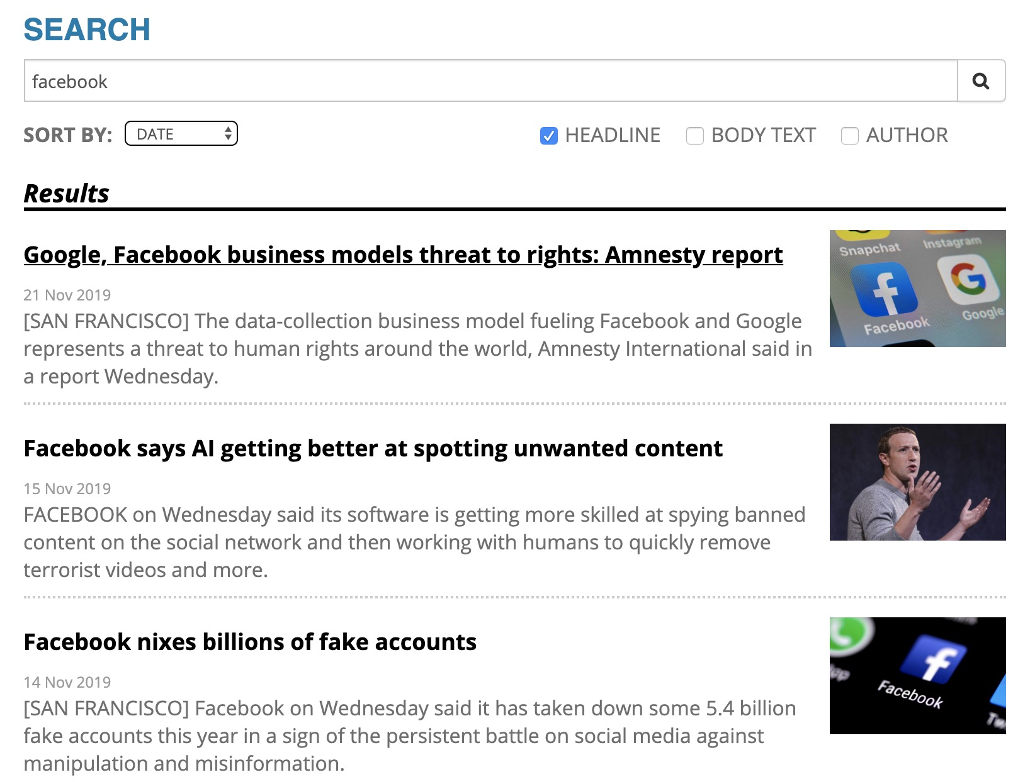
Index Creation
A natural language processing programing based on businesstime.com news content
Index Constituents Selection
Apply BeautifulSoup package to scrap latest 10 news about S&P 500 companies
Apply Sentiment Intensity Analyzer package to analyze the sentiment scores
Positive Words“Gain”，“High Return”
Negative Words ”Worry” , ”Lose”
Automatically select top 15(Project1)/30(Project2) companies with the most positive latest news
Index Strat Price=100, Changed By Daily Weighted Return

Slide 4
SSX Construction & Return
Stock Construction
Noncyclical increasing return
Set individual stock weight by market cap
Graph shows sentiment scores and market cap
Stocks contain Media & Entertainment, Manufacture and Defense industry
We do not have to separate the return into two different periods, since the index performed quite well during the financial crisis.
Well performed return than S&P 500
﻿￼
﻿￼

Slide 5
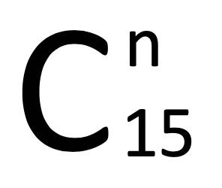
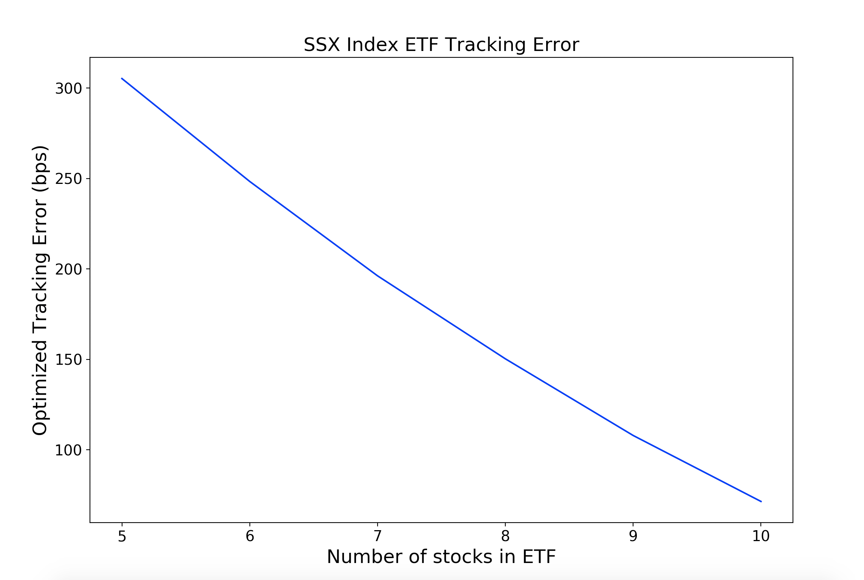
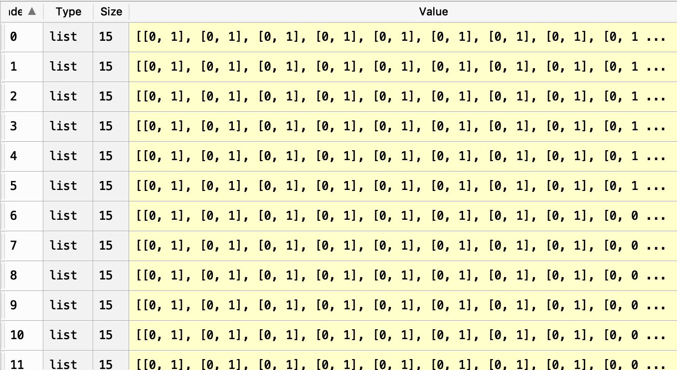
ETF Optimization – SSX Index
How to calculate optimized weighted in ETF
How many stocks (n) in ETF
Apply binary combination function to create different binary lists without duplications and omissions
After creating matrix of all possible combination, we set different lists as the bound in optimizer to find minimized Tracking Error.
Build a loop for n in range(5,11)
For each n, we will calculate a minimum Tracking Error
Draw a plot for different n with minimum TE
n = 10 is our result

Slide 6
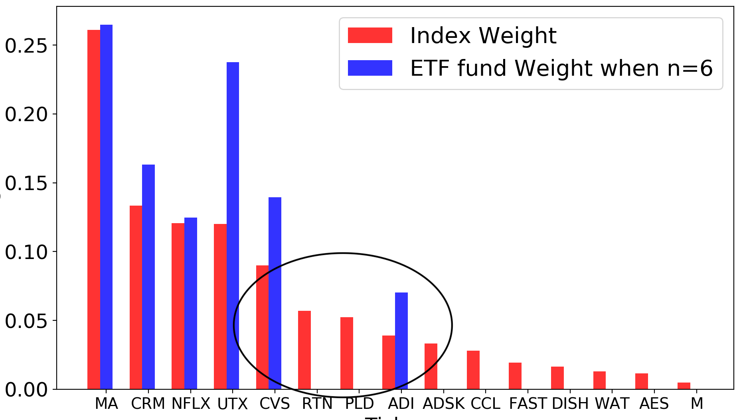
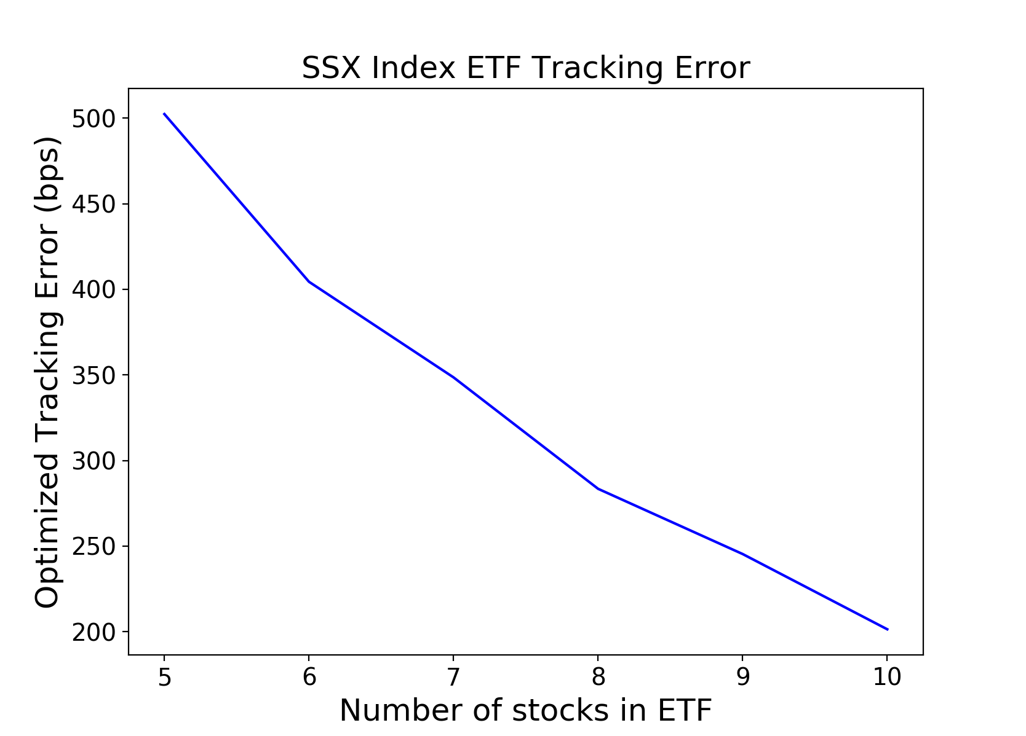
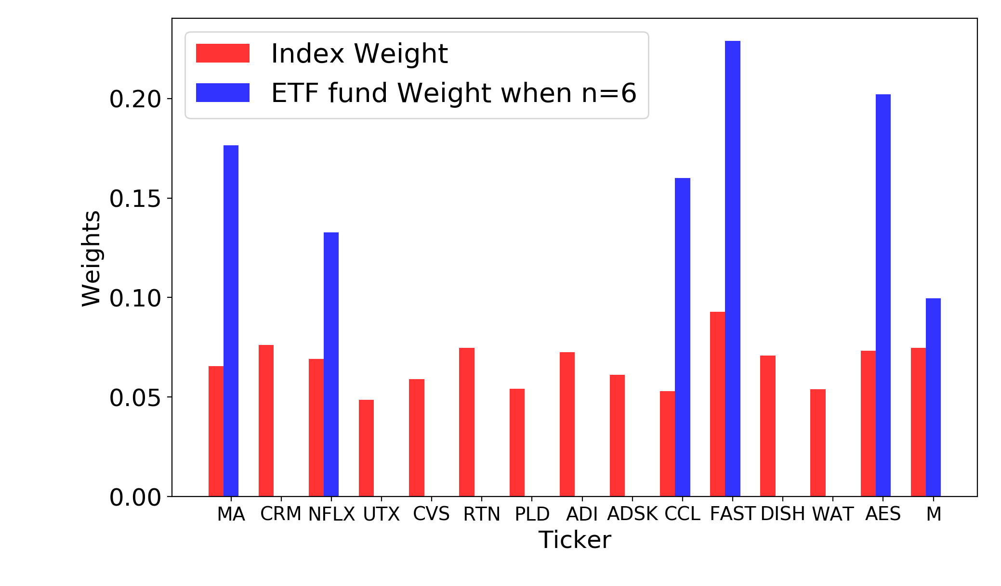
Interest Findings and Further Research
Interest Findings
Most of the assets are selected by weight (Top weighted selection)
Exception: when n=6&8, the assets selection is not according to top weighted range.
Further Research
Change the market cap weighted of our index to equal weighted
We find that the stocks are selected by correlations.
When correlations to other stocks are approaching to 0, this stock will more likely to be selected and given higher weight.
Tracking Error decreased rate by n.

Slide 7
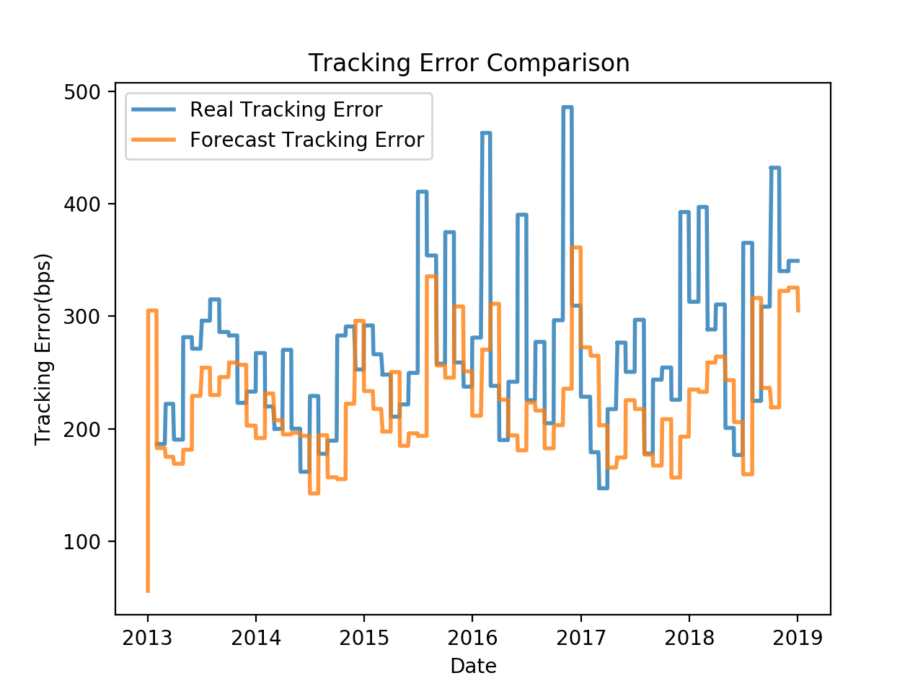
Train Test Split & Conclusion
Conclusions
Advantages:
All the stocks are selected with positive sentiment
High index return and noncyclical pattern
Disadvantages:
Only select 15 stocks, which is not enough to diversify
Train & Test
Train 2007-2013, Rolling Test 2013-2019. Window = 30 days
Optimized weight change time period = 30 days
Realized TE always a little bit higher than Forecast TE
TEs (when n=5) are higher than TEs (when n=10)
Forecasted TE obviously smaller than realized TE, when n=10
N=10
N=5

Slide 8
PART 02
Portfolio Construction (Risk Parity)
Select proper assets in portfolio to minimize the risk and calculate Sharpe Ratio by time period

Slide 9
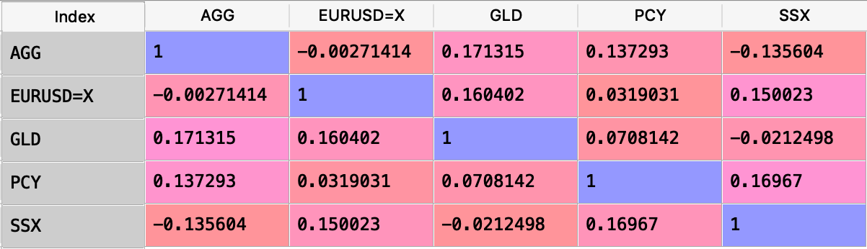
Portfolio Construction
Index Selection
SPDR Gold Shares (GLD) -- Commodity
EUR/USD (EURUSD=X) -- Currency
iShares Core U.S. Aggregate Bond ETF (AGG) -- U.S. government & corporate bond
Invesco Emerging Markets Sovereign Debt ETF (PCY) -- Emerging country’s government bond
Stock Sentiment Index (SSX) -- Sentiment Index created by ourselves (contain 30 stocks)
All of them are irrelevant and with high Sharpe Ratios

Slide 10
Time Split
Period 1 – 2008/03/31 – 2009/03/31
Period 2: 2009/04/01 – 2018/12/31
Window = 90 days
Lamda = 0.94
Varmodel = ma
Leverage = True
During Crisis:
Return of risk parity was lower than return of equal weighted portfolio
No winners during crisis
After Crisis:
Return of risk parity was higher than return of equal weighted portfolio
SSX - Highest cumulative return
Risk Parity - Highest Sharpe Ratio

Slide 11
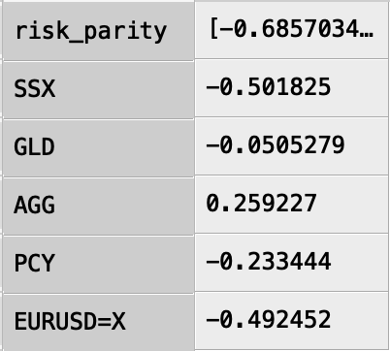
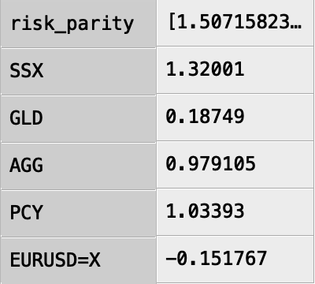
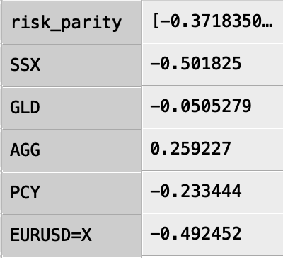
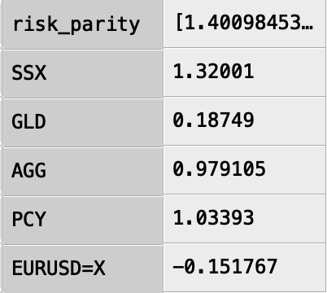
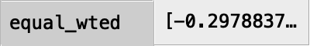
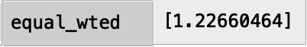
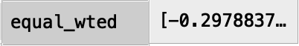
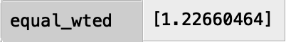
Conclusions – Sharpe Ratio Table
Sharp Ratio table with leverage (200%)
Sharp Ratio table without leverage
Period 1
Period 2
Period 1
Period 2
Conclusions:
We did not take period one into consideration in our risk parity portfolio
Risk parity has the highest Sharp Ratio during period 2 no matter with or without leverage
Only risk parity portfolio has different Sharp Ratio (higher) when the leverage is 200%
Investment insight: Risk parity portfolio has the lowest risk and highest sharp ratio

Slide 12
Q & A
Thank You

